Slide 1
BMI Prediction Using Machine Learning (ML) Methodologies

Slide 2
Group mates!
Supraja Bathula(700735187): Data collection and wrangling
Jagadeesh Naidu(700730988): Data visualization
Vikram Reddy Settypalli (700740663): Algorithms implementation
Bhanu Prakash Dhusari(700726879): Remaining algorithms implementation and documentation
Roles and responsibilities:

Slide 3
Introduction
The WHO defines overweight and obesity as excessive fat buildup in several bodily parts. It causes many diseases and mortality, making it a major public health concern.
Obesity is connected to type 2 diabetes mellitus, hypertension, stroke, osteoarthritis, depression, Alzheimer's, breast, prostate, kidney, ovary, liver, and colon cancer.
An adult is overweight if his BMI is 25 kg/m2 or more, and obese if it exceeds 30 kg/m2.
According to WHO assessments, obesity has roughly doubled worldwide, becoming a problem in both developed and developing countries.
Epidemiological data is increasingly modelled using ML.
These methods may help us understand disease propagation, detection, risk factors, and intervention. Obesity-related health data has been analysed using several ML methods.
In obesity, accurate data categorization helps identify anticipated risk variables from existing data to control these risk factors and reduce obesity-related morbidity and death.

Slide 4
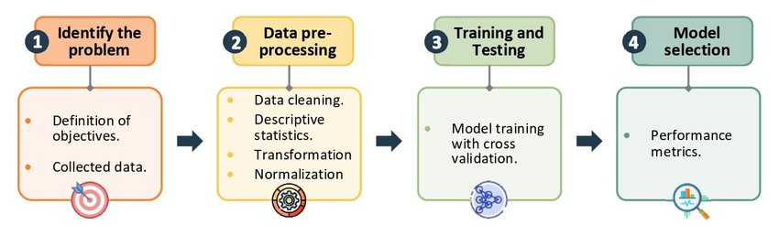
Methodology
For making our predictive model analysis we will need to proceed with certain steps
Dataset loading & Preparation
Data visualization
Assign our data instances and the target value (X and y columns)
Split data into training and test sets
Train our model (Deep Forest & SVM & RandomForest)
Test and evaluate the model

Slide 5
Datasets
The data we use here is the set of 500 with columns Gender, Height, weight, and index.
The index has 5 values. They are:
0= Extremely weak: BMI<16
1=Weak: 16<BMI<18.5
2=Normal: 18.5<BMI<24.9
3= Overweight:25<BMI<29.9
4=Obesity:30<BMI 34.9
5= Extreme obesity: BMI>35
The dataset determines how accurate the algorithms are, thus we cleanse the dataset first before improving results.
Perform feature extraction if indeed the information is enormous.
Age in years, weight in kilos, height in centimeters, sexuality like a male or female, BMI throughout weight per square meters, and 0 to 6 rates of obesity - are among the factors inside the database having respective measurements specified.

Slide 6
Data Preparation
Dataset balancing
Classification models trained with imbalanced data tend to produce biased predictions with incorrect results, therefore in many circumstances, classes with fewer occurrences are insufficient for the model, and a sub-process is required to balance the data [21, 22].
In this instance, the classes in the gathered dataset were uneven; hence, the "oversampling" approach was used to balance the minority classes in the training dataset.
Categorical data encoding
About 80% of the variables in the utilized database were categorical, necessitating the employment of data transformation methods since certain machine learning algorithms prohibit the inclusion of non-numerical data.
The attributes of the gender property are encoded using ordinal encoding rather than one hot encoding.
To change the target feature's classes, the label encoding approach was used

Slide 7
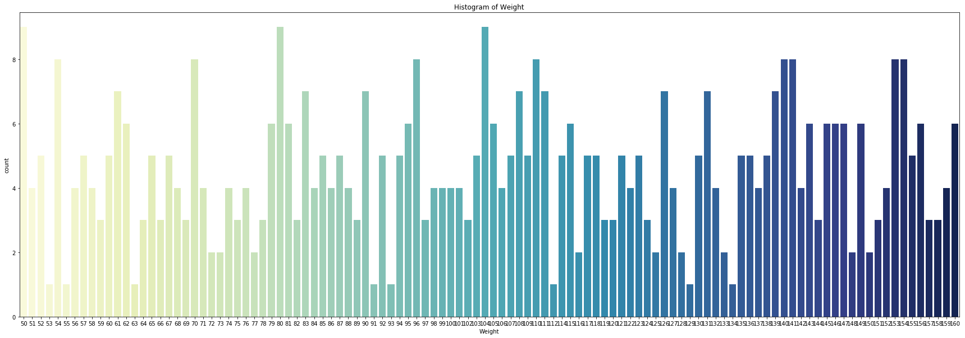
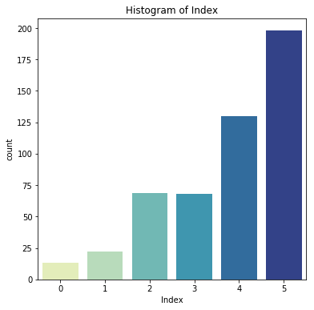
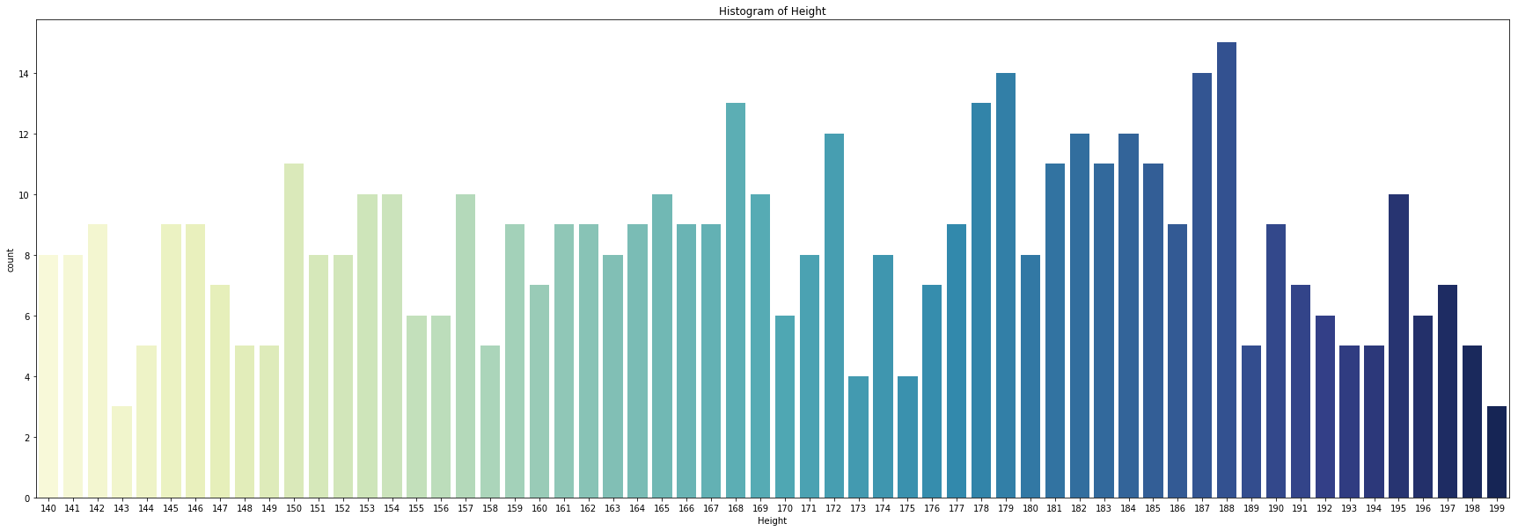
Data Visualization
Frequency of values falling under certain height intervals
Frequency of values falling under each Index [0,1,2,3,4,5]
Frequency of values falling under certain weight intervals

Slide 8
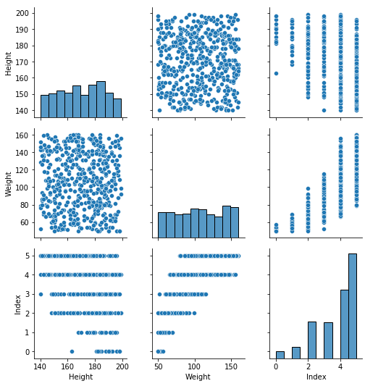
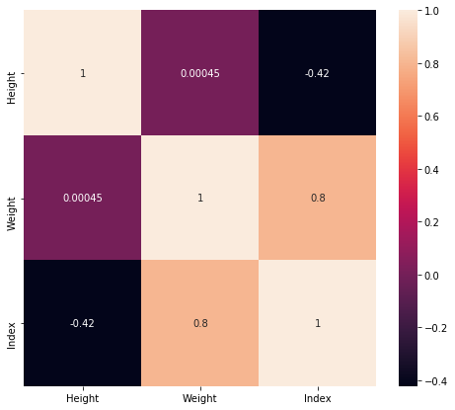
Data Visualization
Pair plot
Correlation

Slide 9
Modeling
I. Support Vector Machine (SVM)
Support Vector Machine (SVM) is a supervised machine learning algorithm frequently utilized in pattern recognition and classification challenges for multiclass classification.
Python's multiclass support is handled according to a one-vs-one approach, where each classifier distinguishes between two distinct classes, and the combination of all one-vs-one classifiers results in a multiclass classifier.
II. GC forest
gcForest uses a cascade structure, in which each level of the cascade receives feature information that has already been processed by the level before it.
An ensemble of decision tree forests (also known as an ensemble of ensembles) is used to construct each level of the hierarchy.
For the sake of diversity, we've included a variety of forest kinds here.
Each forest can produce an estimate of class distribution for a given instance by counting the percentage of different classes of training examples at the leaf node where the instance in question is located, and then averaging the results across all trees in the same forest.
III. Random Forest
Random Forest for Multiclass because it gives the greatest prediction rate in healthcare datasets when compared to other classification algorithms.
Random Forest utilizes averaging to increase prediction accuracy and control over-fitting can handle a high number of features, and is useful for predicting which variables are significant in the underlying data being modeled.

Slide 10
Validation Method
Confusion matrix. It helps to evaluate the quality of the classification model and is represented by a matrix, which allows visualizing the performance of each class of the prediction model
Accuracy. Defined as the sum of the total of true positives and true negatives divided by the total number of results
Precision. Defined as the ratio of the number of correctly predicted true positives to the total number of predicted positives.
Recall. It is also known as the true positives rate. Defined as the ratio of the number of correct positives to the total predictions classified as positives
F1-score. A single measure that combines the sensitivity and precision value of the prediction model

Slide 11
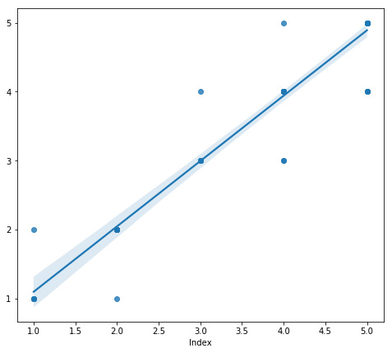
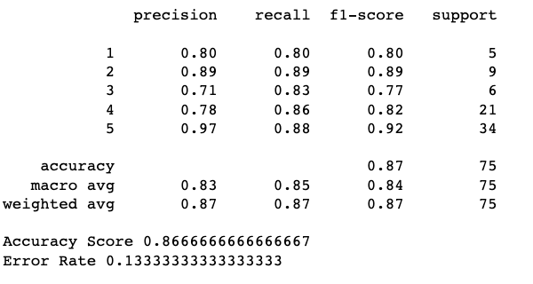
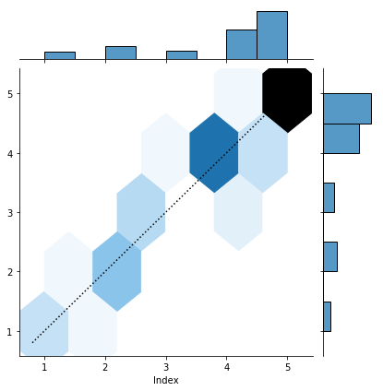
Results - RandomForest

Slide 12
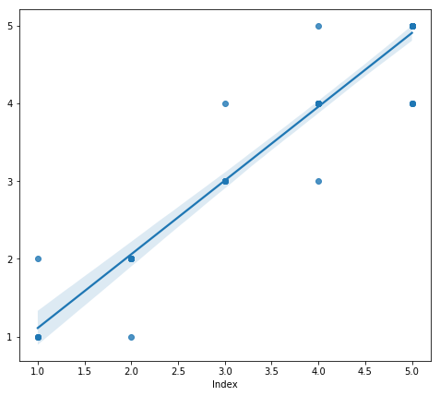
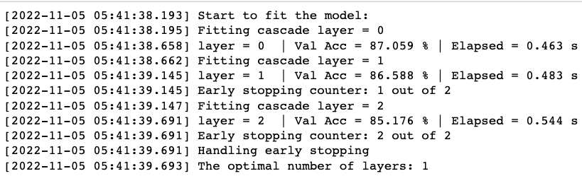
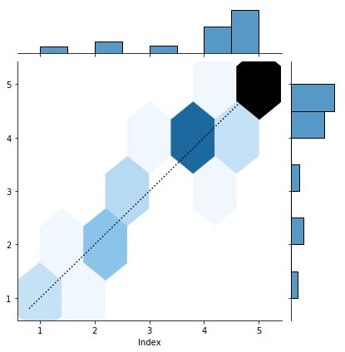
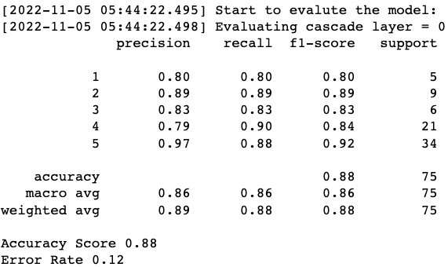
Results - GcForest

Slide 13

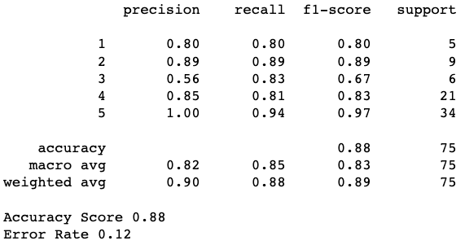
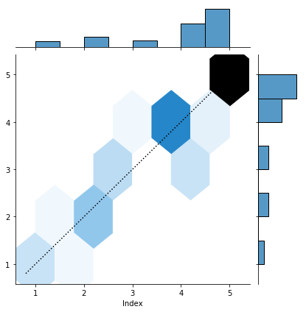
Results - SVM

Slide 14
Conclusion & Future work
Obesity and overweight are epidemiological problems because they are linked to hypertension, type 2 diabetes mellitus, osteoarthritis, stroke, several cancers, and death.
The global prevalence of overweight and obesity is expected to reach 50% by 2030.
Government, industry, and subject matter specialists are needed to fight obesity.
Thus, addressing obesity and its effects requires major lifestyle adjustments, notably in diet and exercise.
Due to technology advances, artificial intelligence and machine learning may help diagnose and prevent overweight and obesity.
Machine learning models can help doctors make decisions.
This research investigated three machine learning models—random forest, support vector machines, and deep forest—to construct an intelligent model for identifying obese or overweight patients to help professionals make decisions.
The model's data came from a survey regarding respondents' diets and exercise.
BMI categorization using weight and height labelled the database.

Slide 15
Reference
World Health Organization (WHO), Obesity and overweight, 2021. URL: https://www.who.int/news-room/fact-sheets/detail/obesity-and-overweight.
H. Rosen, “Is Obesity A Disease or A Behavior Abnormality? Did the AMA Get It Right?”. Missouri medicine, 111(2014): 104–108.
M. Blüher, “Obesity: global epidemiology and pathogenesis”. Nature Reviews Endocrinology, 15(2019): 288–298. DOI: 10.1038/s41574-019-0176-8.
World Health Organization (WHO), Body mass index–BMI, 2020. URL: https://www.euro.who.int/en/health-topics/disease-prevention/nutrition/a-healthy-lifestyle/bodymass-index-bmi
T. Bhurosy, R. Jeewon, “Overweight and obesity epidemic in developing countries: a problem with diet, physical activity, or socioeconomic status?”. The Scientific World Journal, (2014). doi:10.1155/2014/964236.
A. Alami, A. Jafari, Z. Hosseini, “Differences in overweight/obesity prevalence by demographic characteristics and self-weight misperception status”. Clinical Nutrition ESPEN, 41(2021): 249–253. doi:10.1016/j.clnesp.2020.12.005.
World Health Organization (WHO), NCD risk factors: Overweight / Obesity, 2021. URL:https://www.who.int/data/gho/data/themes/topics/indicator-groups/indicator-groupdetails/GHO/overweight-obesity.
Kelly, W. Yang, C.-S. Chen, K. Reynolds, J. He, “Global burden of obesity in 2005 and projections to 2030”. International Journal of Obesity, 32(2008): 1431–1437.

